Slide 1
Capstone Design Proposal Presentation

Slide 2
Hello!
We are “LAJI”
-Jisu An
-Hyunjae Lee
-Jinwoo Jeon

Slide 3
Meet the Team
1
ㅇ
AN JISU
LEE HYUNJAE
JEON JINWOO
Jane Doe
Jane Doe
Jane Doe
BACKEND DEVELOPER
backend developer
FRONTEND DEVELOPER
Server management, Server-side development
Database, Server-side development
Highlight algorithm, Dashboard UI
ajs7270@gmail.com
leehj8687@email.com
zinuzian@gmail.com
Notes:
© Copyright Showeet.com – Creative & Free PowerPoint Templates

Slide 4
Contents
Project overview
Feedback reviews
4th week’s progress
Additional works
Schedule
Q&A

Slide 5
Project overview
What needs do we have?

Slide 6
Feedback reviews
What needs do we have?

Slide 7
4th week’s progress
User Interface
Database construction
Login with Google

Slide 8
4th week’s progress
Database construction

Slide 9
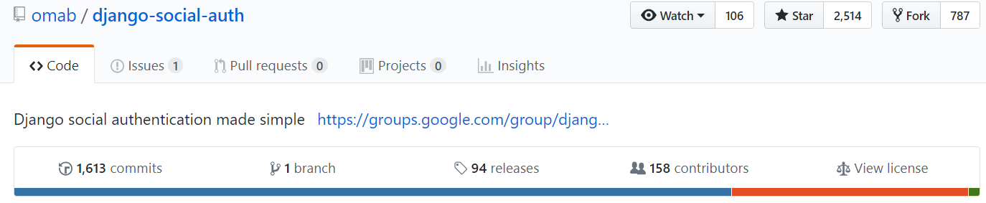
4th week’s progress
Login with Google

Slide 10
Additional works
How do we get videos?
How do we get chats from videos?

Slide 11
Additional works
How do we get chats from videos?

Slide 12
Development plans
Week | Plan
1st | Idea & Proposal
2nd | Idea & Proposal
3rd | Server construction (Configuration setup : Nginx, domain(bind9), https), Test videos (Twitch/Game/Eng)
4th | Login (SNS), Database
5th | Video upload & download, Twitch chat API analyze
6th | Frame resizing, Web UI, Designing highlight algorithm
7th | Demo

Slide 13
Development plans
8th | Highlight video analyze algorithm development and test
9th | Highlight video analyze algorithm development and test
10th | Highlight video analyze algorithm development and test
11st | Toss (payment), Test
12nd | Notification mail, Server test
13rd | Preparing for Final demo
14th | Final demo
15th | Final report

Slide 14
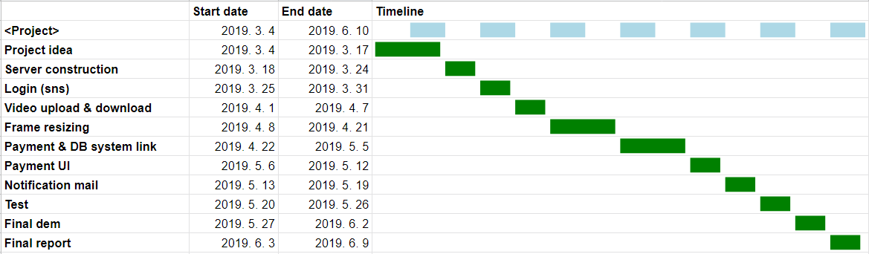
Development plans
Jisu An,

Slide 15
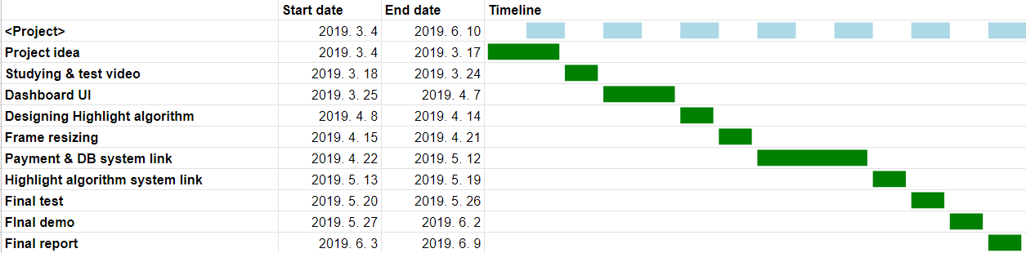
Development plans
Hyunjae Lee,

Slide 16
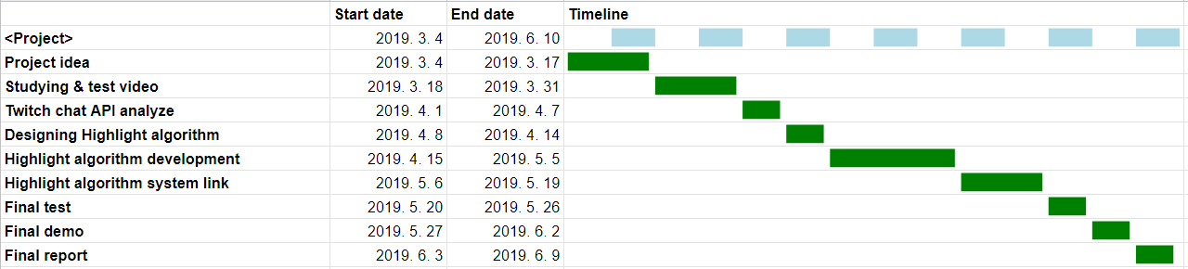
Development plans
Jinwoo Jeon,

Slide 17
Thank you!

Slide 18
USER
:ID(PK)
:name
:email(PK)
VIDEO
:ID(PK)
:title
:length
:url
:dir
:resizing(null)
:
CHAT
:ID(PK)
:title
Highlight
:ID(PK)
:title
:length
:url

